Slide 1

Colab Tutorial
Hands on Artificial Intelligence and Robotics
Lingxiao Wang, Ph.D.
Assistant Professor of Electrical Engineering
Louisiana Tech University

Slide 2
Colab Tutorial
Link to access this tutorial on Colab: https://colab.research.google.com/drive/1ugSGXtcM2gAhLArGQzWpUro0snNjg5VQ?usp=sharing
Colab is a Google product that allows you to write and execute Python in your browser, with
Zero configuration required
Free access to GPUs
Share your code to others
……
Website:
https://colab.research.google.com/

Slide 3

Getting Started
Creating a new cell
You can create a new code cell by clicking on +Code or add a text cell by clicking on +Text.
There are options for moving your cell up/down or copy/delete it.

Slide 4


Getting Started
You can type python code in the code cell
You can also use a leading exclamation mark ! to change the code cell to treating the input as a shell script

Slide 5
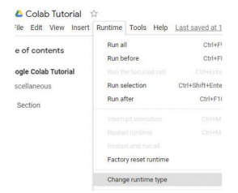
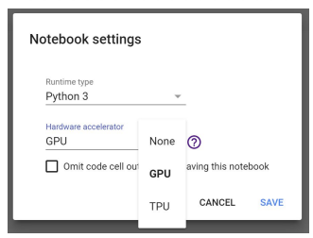
Changing Runtime
To utilize the free GPU provided by google
click on "Runtime"→ "Change Runtime Type“
select "GPU" for "Hardware Accelerator“
Note that doing this will restart the session, so make sure you change to the desired runtime before executing any code.

Slide 6
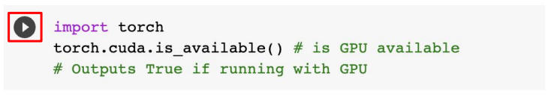
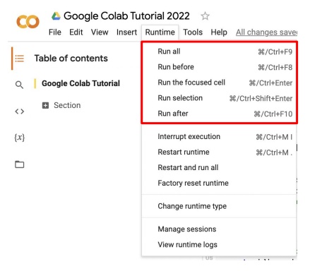
Executing Code Block
Click on the play button to execute a specific code cell
In Runtime menu, there are other options to run your code:

Slide 7
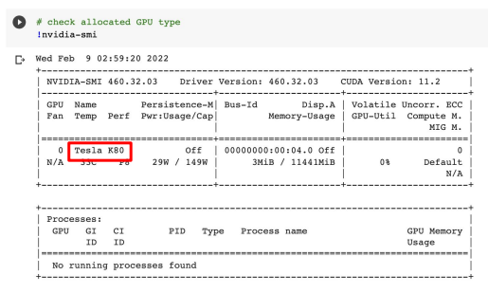
Check GPU Type
Use the command nvidia-smi to check the allocated GPU type
Available GPUs: P100 > T4 > K80 (but most of the time you get K80 using the free Colab)

Slide 8
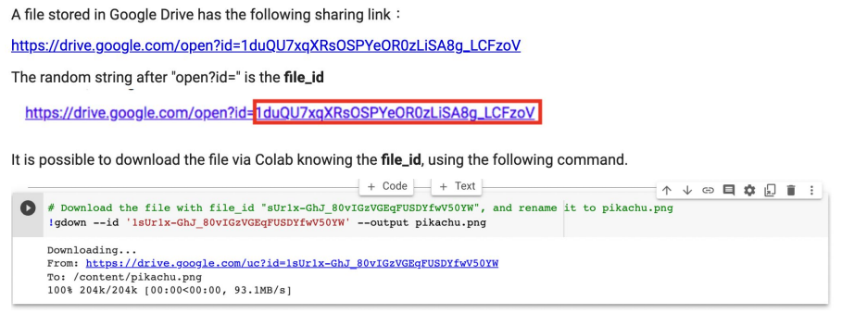
File Manipulation
Download files via Google Drive

Slide 9
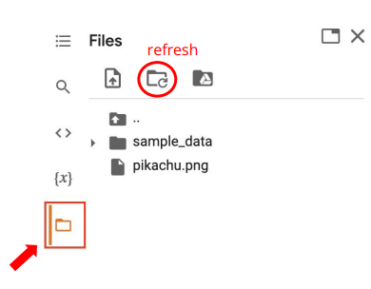
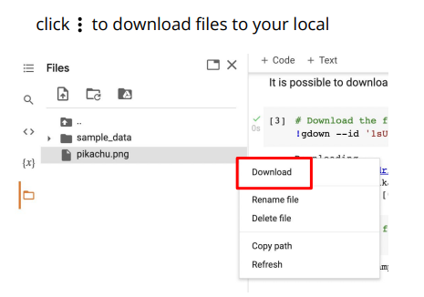
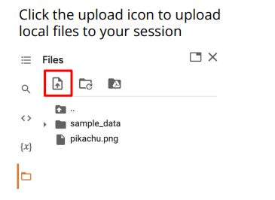
File Manipulation
File Structure
You may click on the folder icon on the left to view your current files
After downloading files, if the files are not immediately shown, click the refresh button
Files are temporarily stored, and will be removed once you end your session.
File Upload and Download

Slide 10
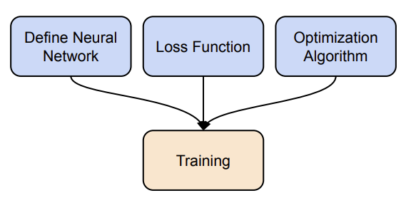
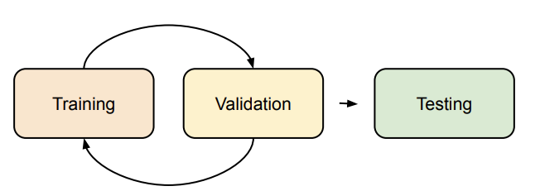
Pytorch Tutorial
Pytorch is a machine learning framework in Python
Official Website: https://pytorch.org/
Two main features
N-dimensional Tensor computation on GPUs
Automatic Differentiation for training deep neural networks
To train a neural network, you need to
Define the neural network
Define the loss function
Define the optimization algorithm
Training and Testing Neural Networks

